Slide 1


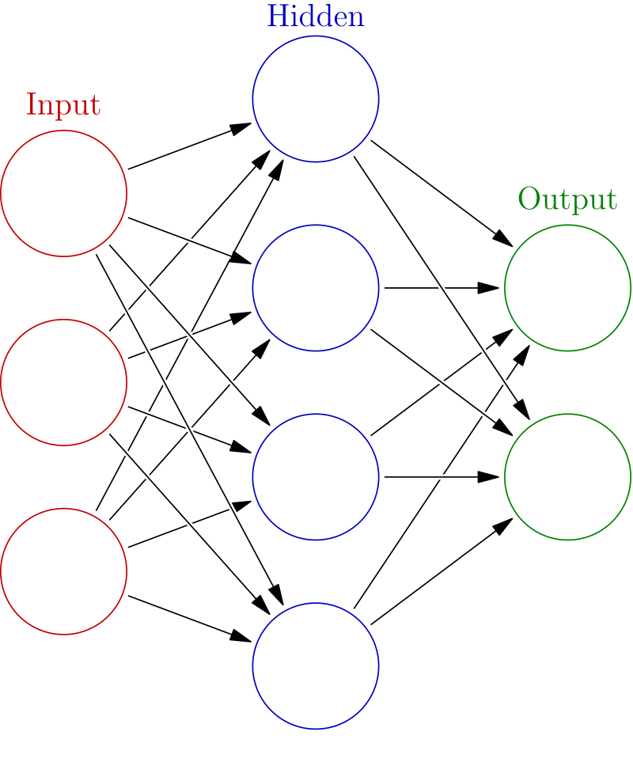
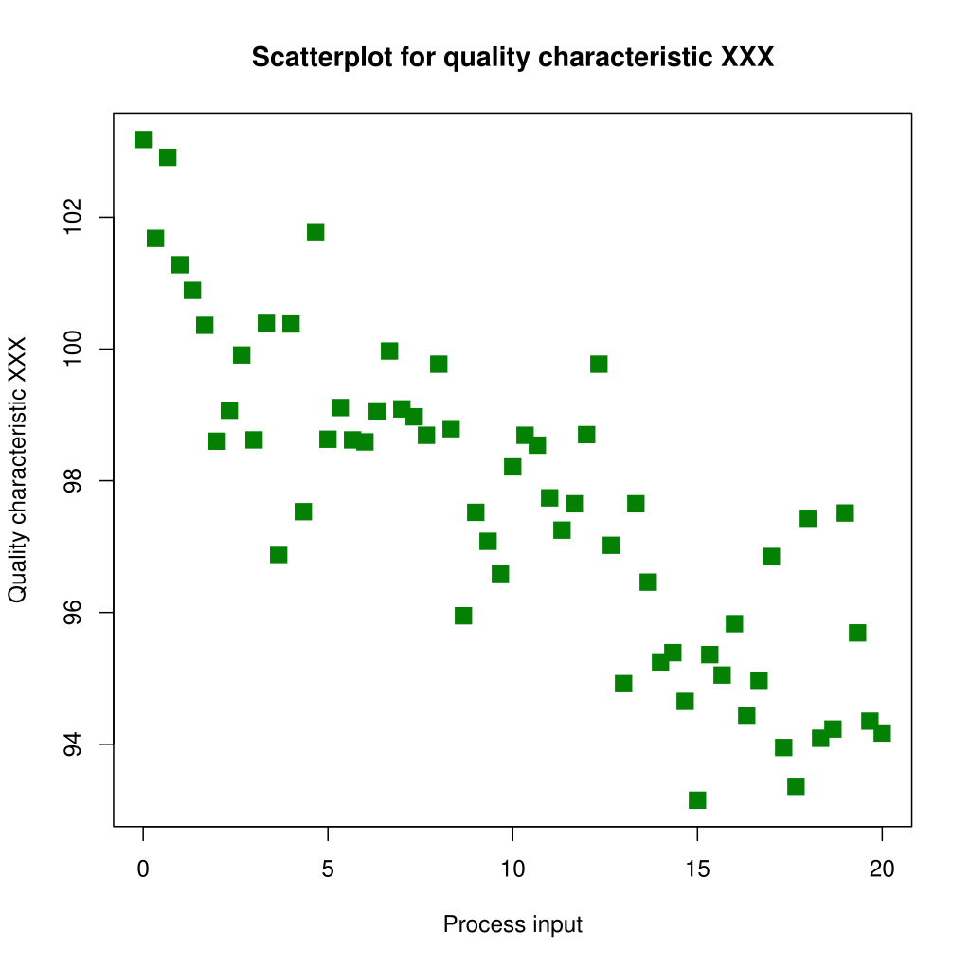
TITLE TITLE TITLE TITLE TITLE TITLE TITLE TITLE TITLE TITLE
First Author*¹ (user@domain.ca), Second Author*², Third Author¹
¹Vision and Image Processing Group, Department of Systems Design Engineering, University of Waterloo, Canada ²Affiliation Number Two, University of ???, Canada * Indicates equal contribution, joint first-authorship.
Introduction
Methods/Design (depending on what makes most sense for you)
Conclusion
Background
Summarize main findings here. Bold key words as part of findings in this column. Limit to key take-aways. Aim to use short sentences. Aim to use plain language. A good rule of thumb: use terminology such that, regardless of field, anyone can understand 80% of what you’re saying.
Summarize main findings here. Bold key words as part of findings in this column. Limit to key take-aways. Aim to use short sentences. Aim to use plain language. A good rule of thumb: use terminology such that, regardless of field, anyone can understand 80% of what you’re saying.
Summarize main findings here. Bold key words as part of findings in this column. Limit to key take-aways. Aim to use short sentences. Aim to use plain language. A good rule of thumb: use terminology such that, regardless of field, anyone can understand 80% of what you’re saying.
Background with bolded key points to guide reader. Include references like this [1]. Use at 28 point fonts for legibility. Aim to not include too much information. Consider this info talking points you can expand on with your verbal discussion. Include just enough info to make sense as a stand-alone. Readers don’t need to understand all the nitty gritty details, focus on the very most important points and aim for 3-5 while addressing:
What’s the problem? Use a very short paragraph to describe.
What’s been done? Use a very short paragraph to describe.
What are the gaps? Use a very short paragraph to describe.
Table 1. Hyperparameters used for experiments.
Parameter | Setting
Loss function | Cross-Entropy
Optimizer | SGD with momentum
Learning rate | 0.01
Momentum | 0.9
Batch-Size | 64
Num. Epochs | 100
Figure 1. Figure caption text here…. E.g., A deep neural network….
Results
Use diagrams wherever possible
Use vector graphics when possible.
Don’t cram results.
Use point form if needed.
Include short descriptions to walk reader through your poster.
Poster Printing Instructions:
1. The recommended poster size is horizontal A0 (841 × 1189 mm). This template is sized to A0, at 100% scaling.
2. If you choose not to print at the recommended size, instead you may create a poster in a horizontal (landscape) or vertical (portrait) format as long as it fits on the bulletin boards, which are 5ft (width) by 4ft (height). Ensure your poster is smaller than this.
3. Ensure you print your posters with enough lead time! At the University of Waterloo, WPrint (https://wstore.uwaterloo.ca/wprint) often requires several business days, especially if there is a high volume of print job submissions.
Goal
The goal(s) of this study were to:
Use numbers to break up goals into primary and secondary etc. outcomes. This is very effective at helping the reader pick up the main points quickly
Use bulleted lists to emphasize the “so what” Of each goal
Bold key words to emphasize aspects of the goal.
Include 3-5 SHORT bullet points to indicate your next steps for your work
Include 3-5 SHORT bullet points to indicate your next steps for your work
Short bullet
Short bullet
Future Directions
Figure 2. Figure caption text here….
[1] Feel free to use a very condensed citation here with just enough info to find the source with as little space as possible.
[2] In long long long long long long long long long long long long long long long long long long long long long long long long references, the second line is automatically indented nicely.
[3] Last et al, “Title title title,” in venue venue venue.
[4] Last et al, “Title title title,” in venue venue venue.
[5] Last et al, “Title title title,” in venue venue venue.
This work was supported by … The authors thank … (Acknowledgements).
Notes:
1. The recommended poster size is horizontal A0 (841 × 1189 mm). This template is sized to A0, at 100% scaling.
2. If you choose not to print at the recommended size, instead you may create a poster in a horizontal (landscape) or vertical (portrait) format as long as it fits on the bulletin boards, which are 5ft (width) by 4ft (height). Ensure your poster is smaller than this.
3. Ensure you print your posters with enough lead time! At the University of Waterloo, WPrint (https://wstore.uwaterloo.ca/wprint) often requires several business days, especially if there is a high volume of print job submissions.
Figures sourced from (under CC BY-SA 3.0): - https://en.wikipedia.org/wiki/Neural_network_(machine_learning)#/media/File:Colored_neural_network.svg
- https://en.wikipedia.org/wiki/Scatter_plot#/media/File:Scatter_diagram_for_quality_characteristic_XXX.svg

